Slide 1

Sunset Little League
Rio Rancho, New Mexico
2018 Safety Training

Slide 2
Agenda
Introduction
Safety and SLL Culture
Our Role – Respect
2018 Bat Standard
Reporting Injuries
Types of Injuries
First Aid
CPR
Summary

Slide 3
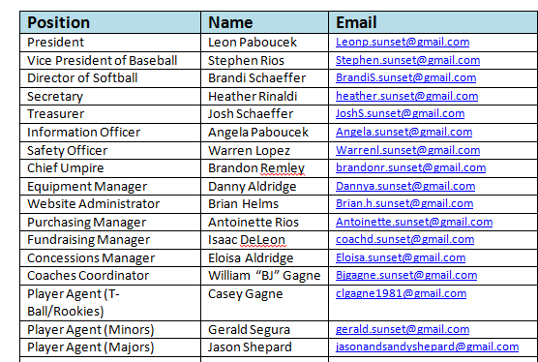
Introduction
Warren Lopez, SLL Safety Officer
SLL Board of Directors:

Slide 4

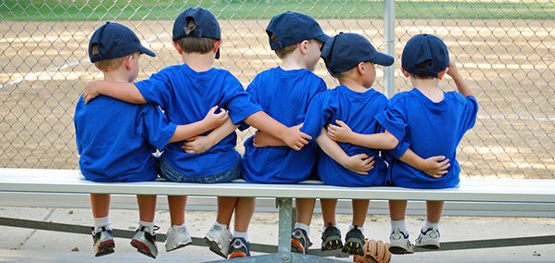
Introduction
Who is Sunset Little League
The Community
  The children
  The Parents & Families
  Volunteers
  Sponsors
  Coaches & Managers
  Board Members
  District, State, Region, Little League International

Slide 5
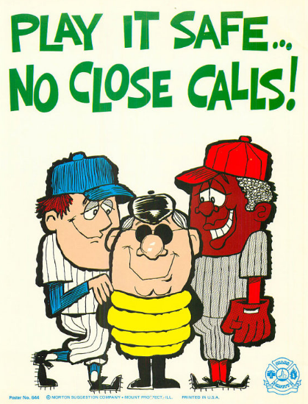
Safety & SLL Culture
“Safety is everyone’s responsibility: managers, coaches, players, spectators, volunteers and umpires. . . Safety is our first priority when practicing, and playing the game of baseball. . . By working together, we can provide a fun and safe playing environment.”
2017 Sunset Little League 2017 Safety Plan, Page 1 Statement of Safety

Slide 6

Our Role - Respect
Preventing Injuries through Safe Play
Assess the fields
Respectful, Encouraging, Responsive
Put the Children First
Lead by example

Slide 7
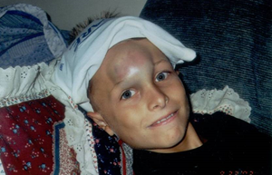
Our Role - Respect
Preventing Injuries

Slide 8

Our Role - Respect

Slide 9



2018 Bat Standard
Baseball Bats 2017 Standard
  USSSA BPF (Bat Performance Factor) 1.15
  Barrel Size Max 2 ¼”
Baseball Bats – new 2018 Standard
  New USABat Bat Stamp
  Barrel Size Max 2 5/8”
  All divisions from T-Ball to Major League
Softball Bats
  2018 Bat Standard is for baseball only
  Previous USSSA BPF 1.20 still applies

Slide 10
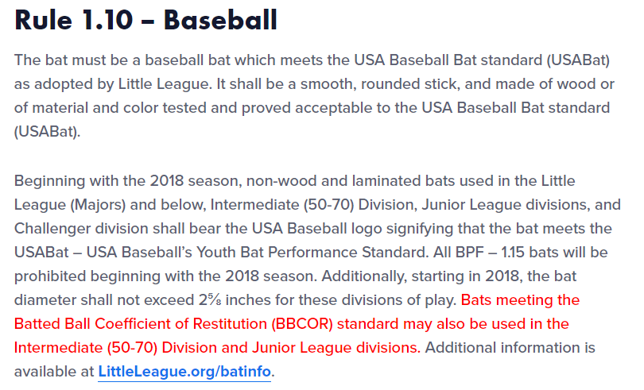
2018 Bat Standard

Slide 11
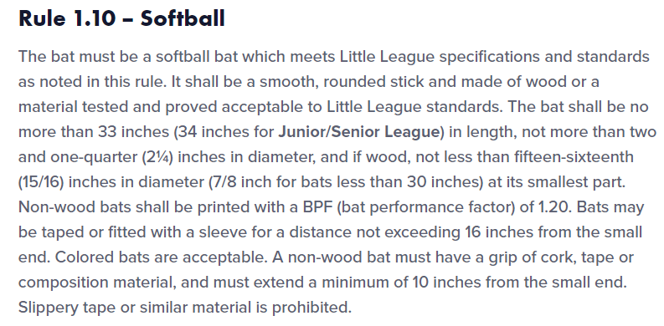
2018 Bat Standard

Slide 12

Reporting Injuries
Report an injury if the injuries may require professional medical attention.
Injury Reports are located at the Concession Stand.
Notify a board member or SLL Safety Officer:
  Warren Lopez, warrenl.sunset@gmail.com

Slide 13
Types of Injuries and Emergencies
Head Injury/Concussion
Cardiac (Heart)
Choking
Allergic Responses (i.e. bee sting/food)
Stroke
Medical Conditions (e.g. diabetic: high/low blood sugar)
Viral (flu)
Other Injuries (broken bone, etc.)

Slide 14
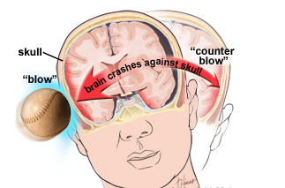
Concussions
WHAT IS A CONCUSSION?
A concussion is an injury that changes how the cells in the brain normally work. A concussion is caused by a blow to the head or body that causes the brain to move rapidly inside the skull. Even a “ding,” “getting your bell rung,” or what seems to be a mild bump or blow to the head can be serious. Concussions can also result from a fall or from players colliding with each other or with obstacles, such as a goalpost.
https://www.nmact.org/file/Facts_4_Families.pdf

Slide 15
Concussions
Observed by the Athlete
Headache or “pressure” in head
Nausea or vomiting
Balance problems or dizziness
Double or blurry vision
Bothered by light
Bothered by noise
Feeling sluggish, hazy, foggy, or groggy
Difficulty paying attention • Memory problems
Confusion
Does not “feel right”
Observed by the Parent / Guardian
Is confused about assignment or position
Forgets an instruction
Is unsure of game, score, or opponent
Moves clumsily
Answers questions slowly
Loses consciousness (even briefly)
Shows behavior or personality changes
Can’t recall events after hit or fall
Appears dazed or stunned

Slide 16
Concussions
State of New Mexico
REFERENCES ON SENATE BILL 38 AND BRAIN INJURIES
Senate Bill 38: https://www.nmlegis.gov/Sessions/17%20Regular/final/SB0038.pdf
https://www.nmact.org/file/Facts_4_Families.pdf
RETURN TO PLAY GUIDELINES UNDER SB38
1. Remove immediately from activity when signs/symptoms are present.
2. Must not return to full activity prior to a minimum of 240 hours (10 days).
3. Release from medical professional required for return.
4. Follow school district’s return to play guidelines.
5. Coaches continue to monitor for signs/symptoms once athletes return to activity

Slide 17

Types of Injuries and Emergencies
A medical emergency is an acute injury or illness that poses an immediate risk to a person’s life or long term health.
https://en.wikipedia.org/wiki/Medical_emergency

Slide 18
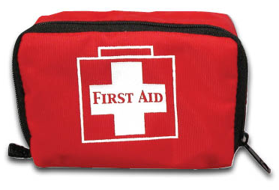
First Aid
Every Manager has been issued a first aid kit
A well stocked first aid kit is located at the Concession Stand
Ice is available at the concession stand
Cell Phone service is available at the concession stand

Slide 19
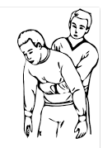
First Aid
Choking Emergency (Heimlich Maneuver)
  Maneuver behind the victim
  Make a fist with your thumb facing toward the victims body
  Place hand in the center of the chest just below the breast bone with the knuckle of your thumb against the victim.
  Place the other hand open on top of the fist
  Thrust vigorously upward until the item blocking the airway is dislodged

Slide 20
CPR
Shout, “Are you awake, can you hear me!”
Determine:
  Is victim unconscious
  Is victim breathing
Call 911 (If by-standers direct them to call 911)
Direct someone to meet EMS
Start Chest Compressions
  Place heel of hand on breast bone
  Center shoulders over hands
  Use body weight to deliver 2” compression
  100 compressions per minute
  Continue until EMS arrives or AED
Use AED if available (shock heart into normal rhythm)

Slide 21
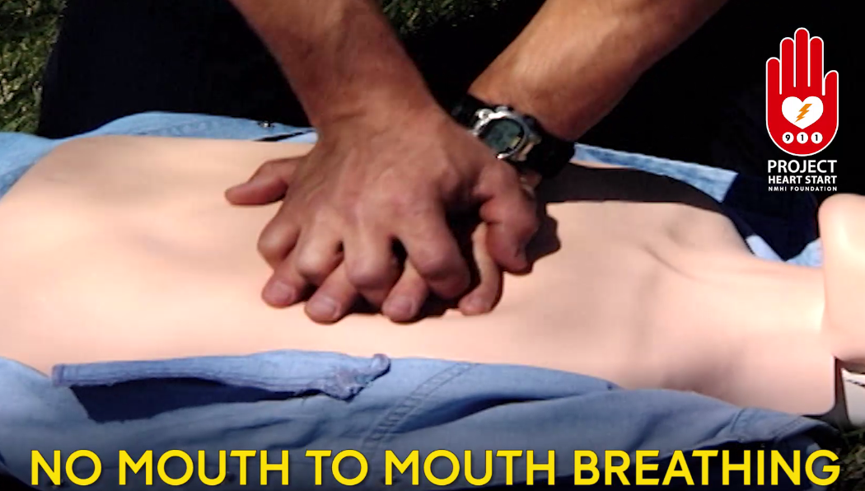
CPR
Location and position of hands

Slide 22
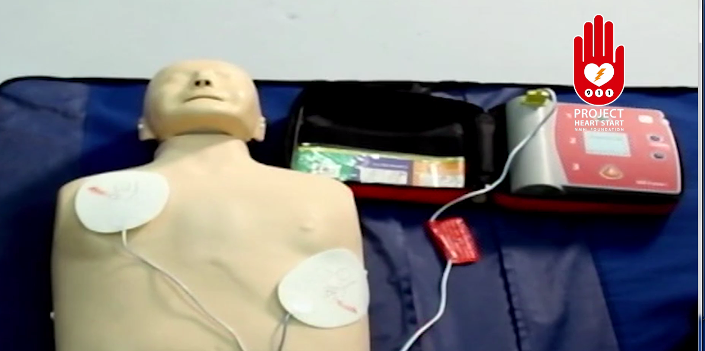
CPR
AED usage and position.

Slide 23


Summary
Introduction
Safety and SLL Culture
Our Role – Respect & Injury Prevention through safe play
Reporting Injuries
Types of Injuries
First Aid
CPR

